Slide 1
Planning in AI

Slide 2
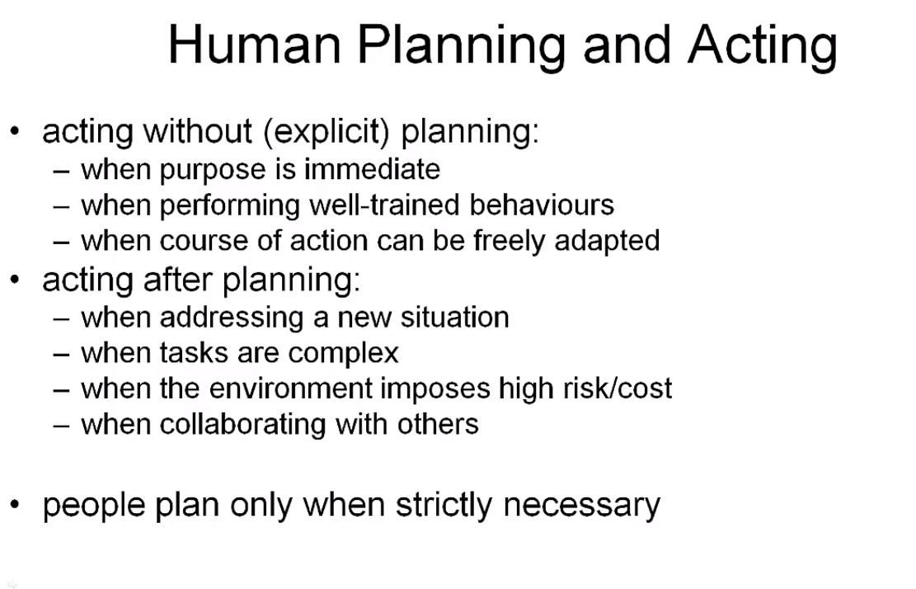

Slide 3
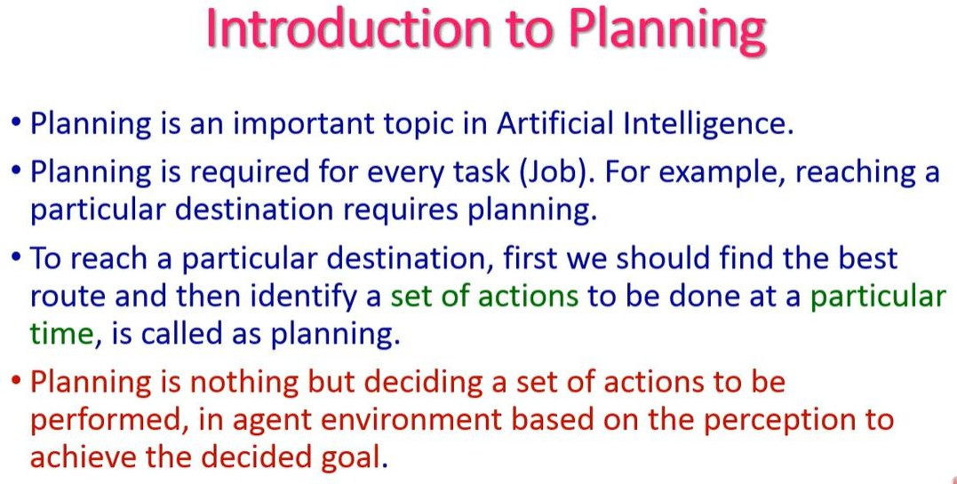

Slide 4
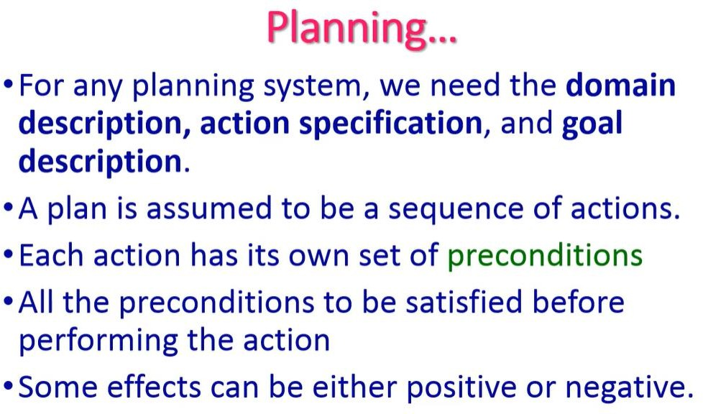
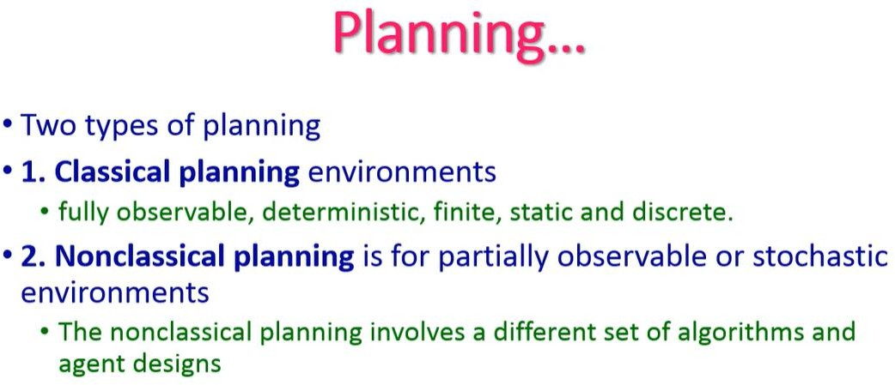

Slide 5
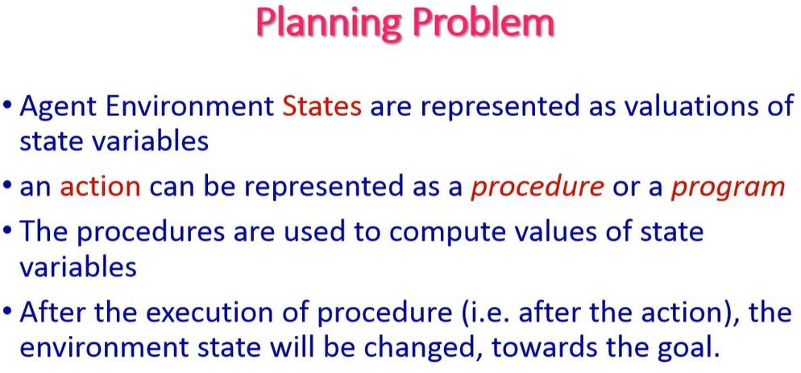

Slide 6
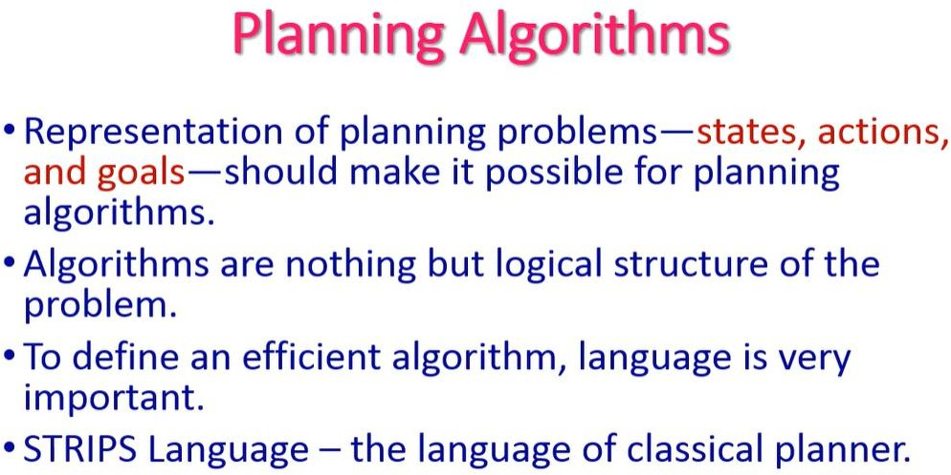

Slide 7
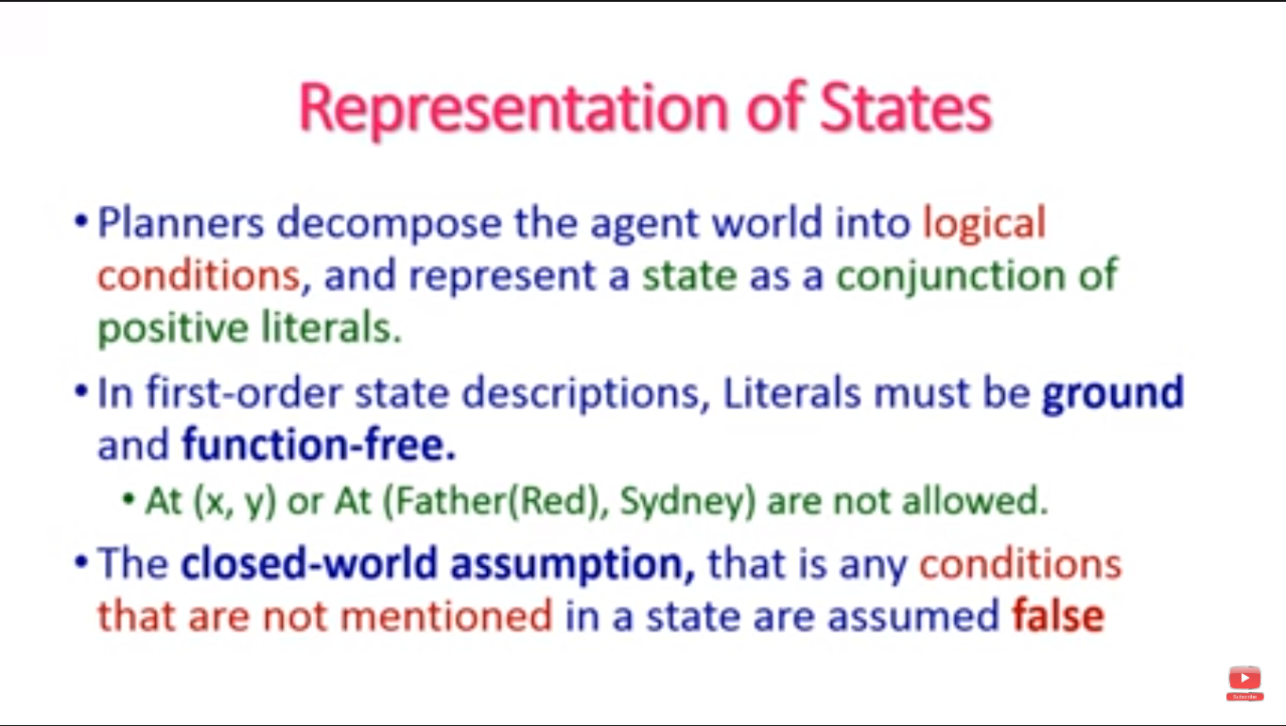

Slide 8
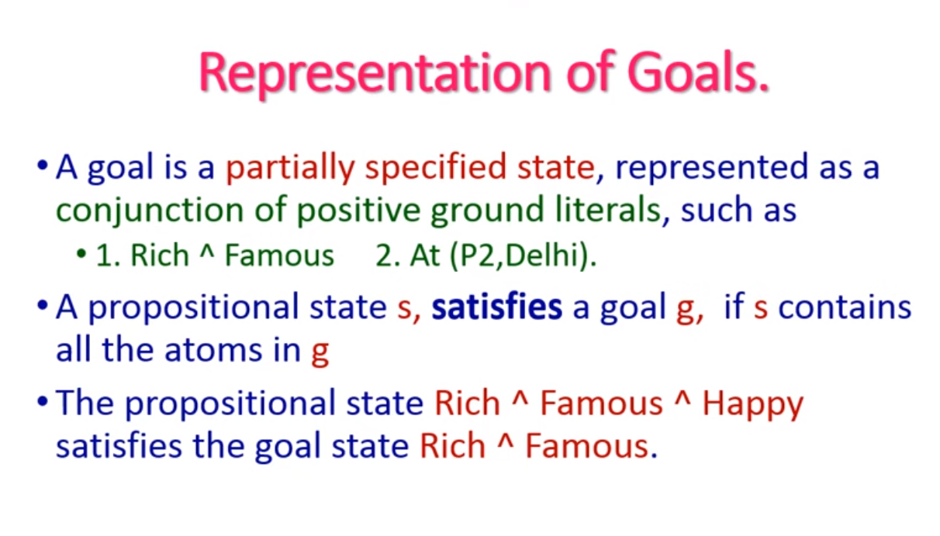

Slide 9
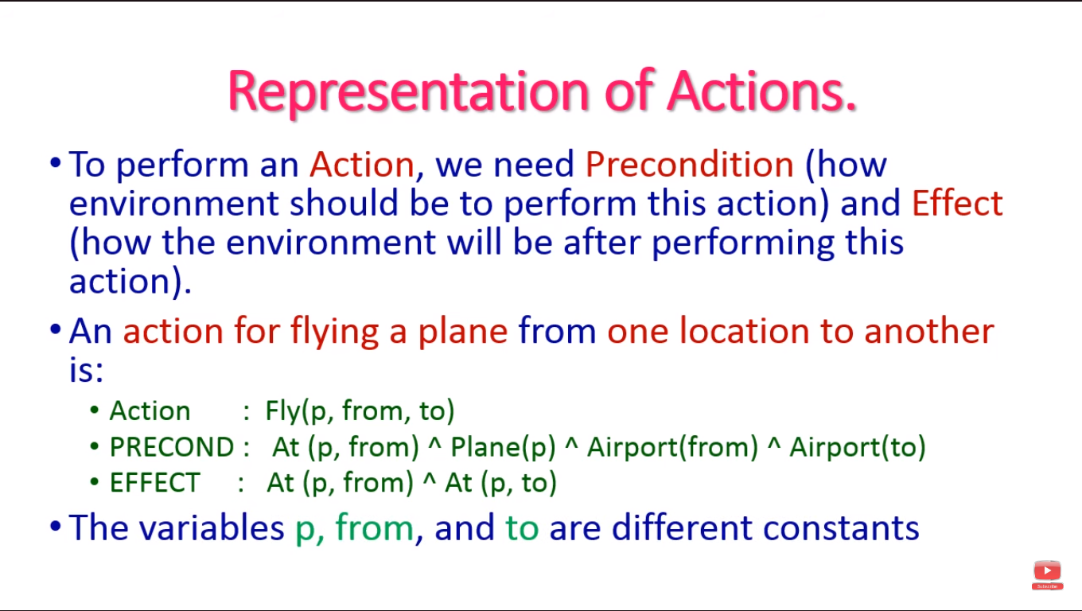

Slide 10
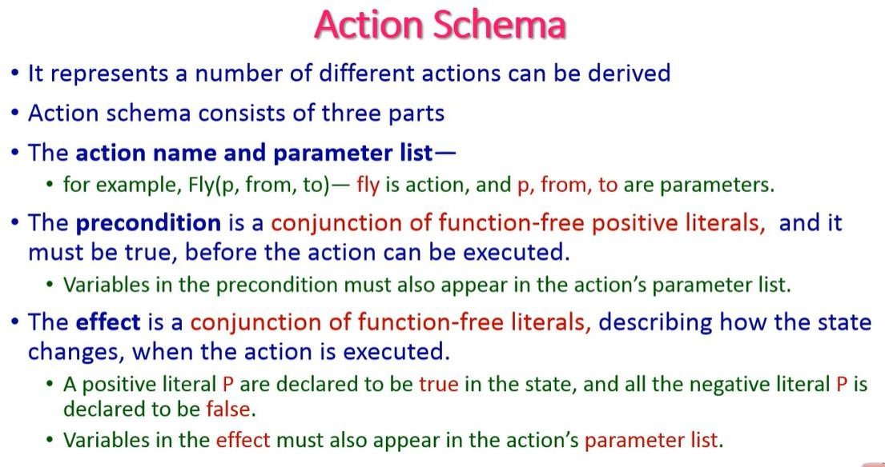

Slide 11
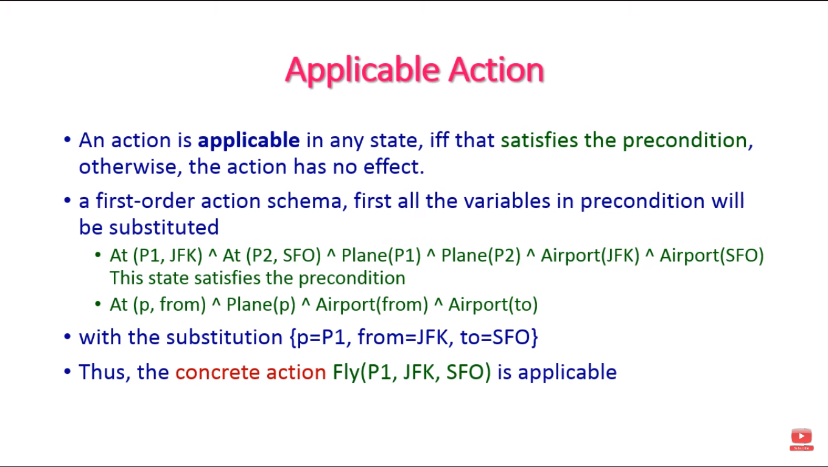

Slide 12
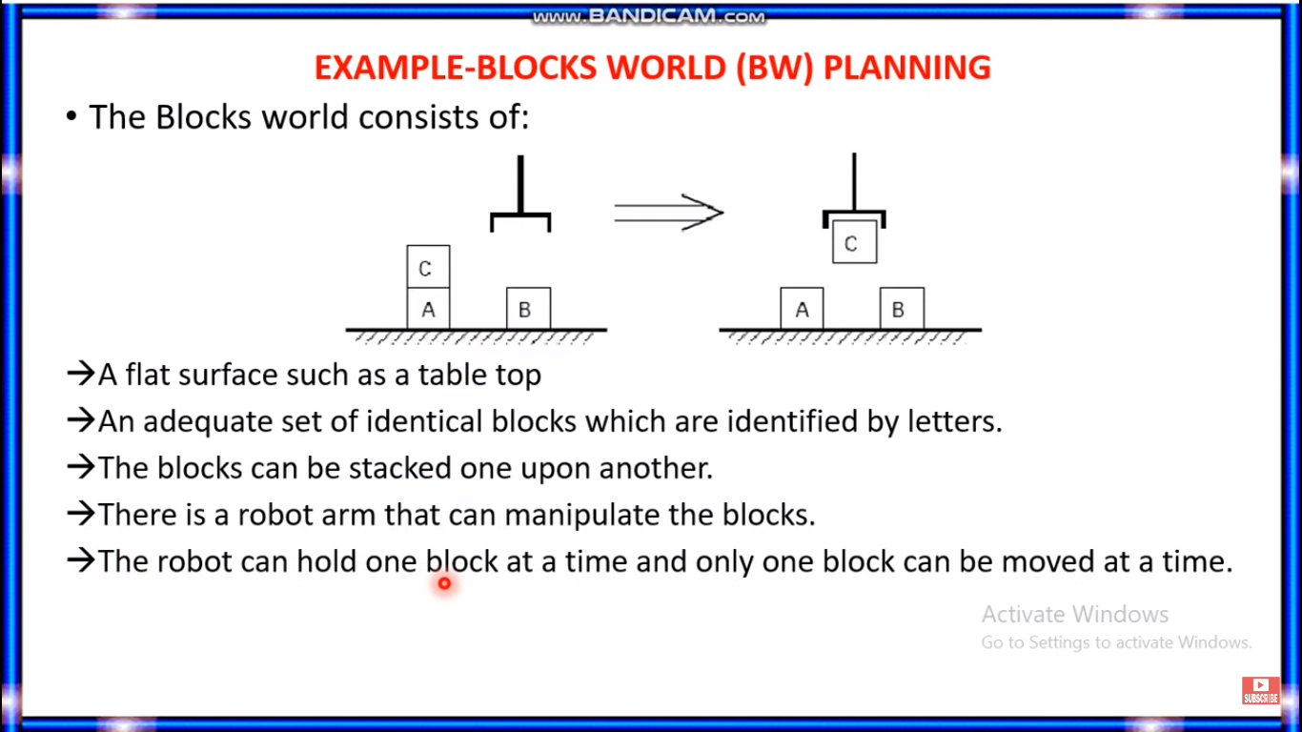

Slide 13
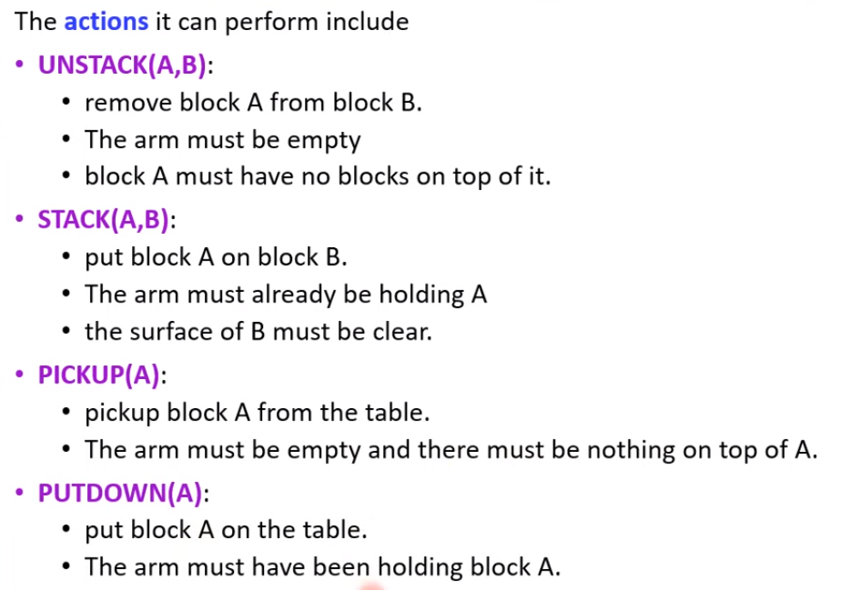

Slide 14
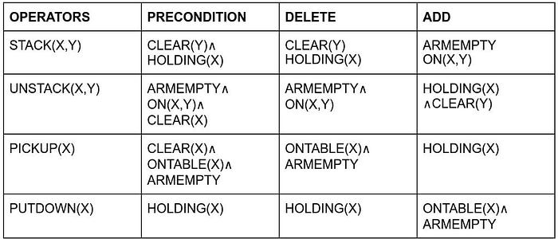

Slide 15
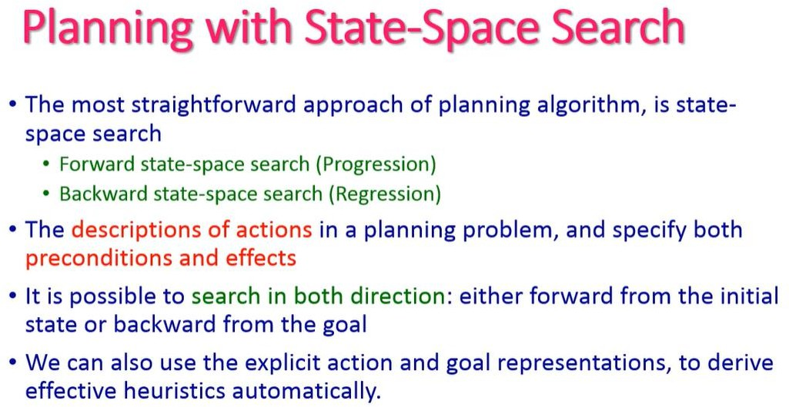

Slide 16
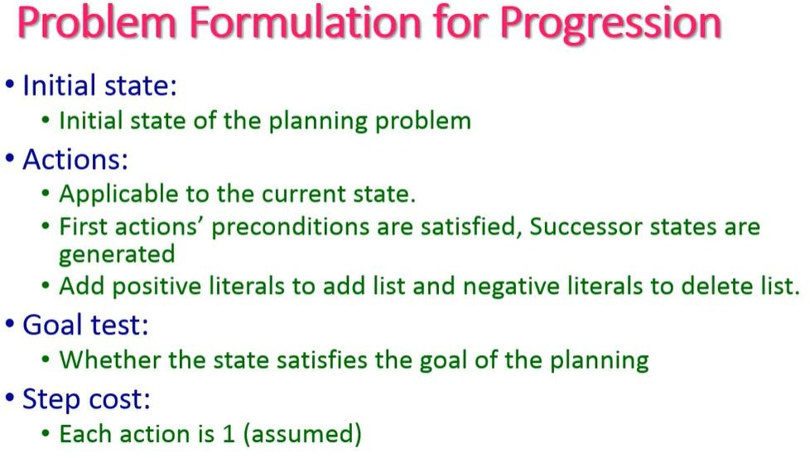

Slide 17
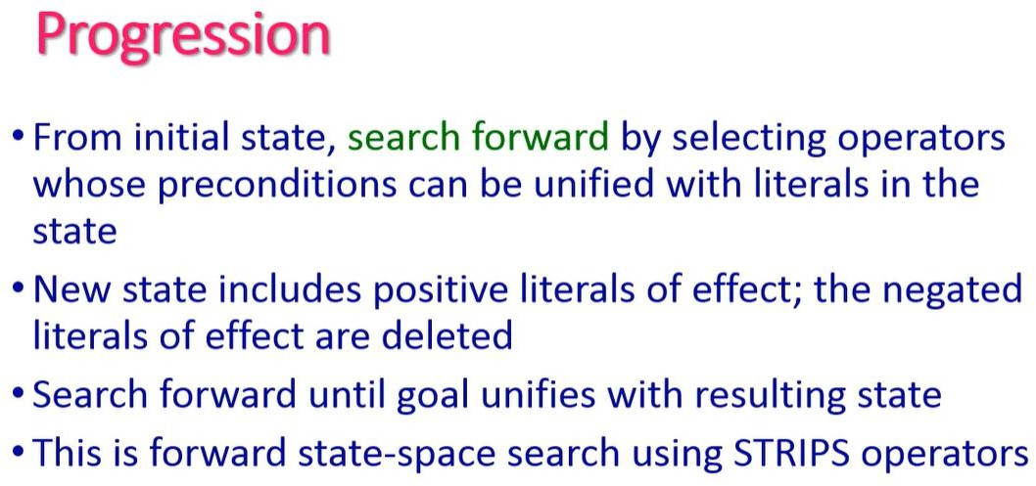

Slide 18
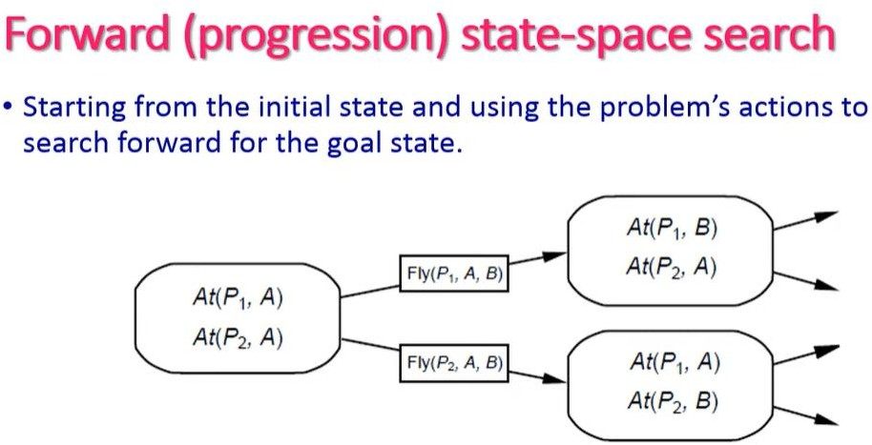

Slide 19
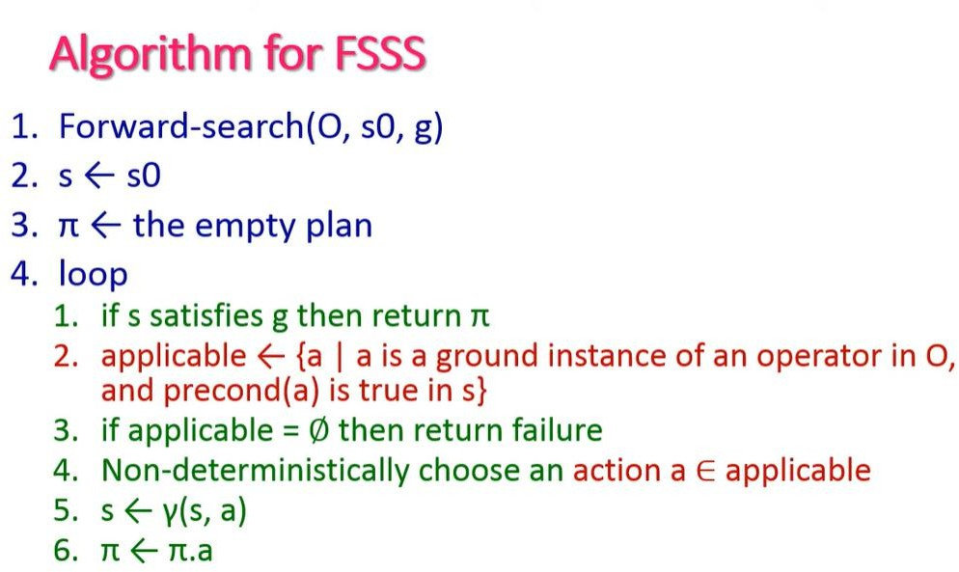

Slide 20
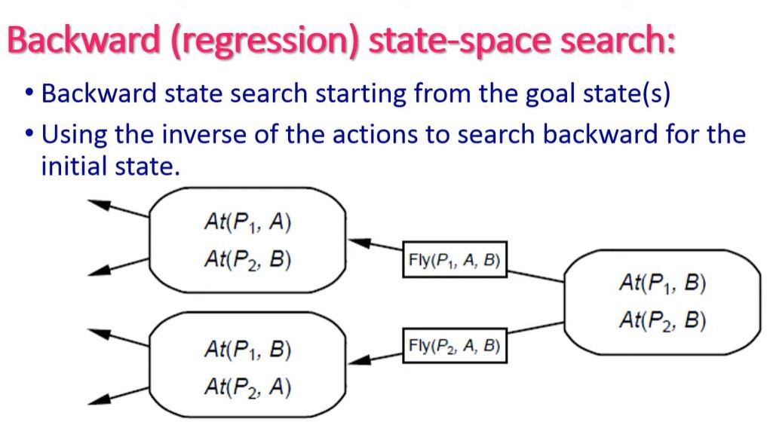

Slide 21
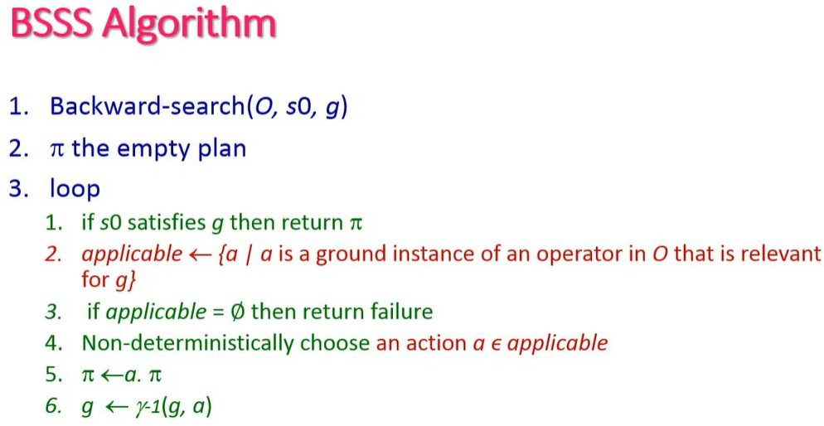

Slide 22
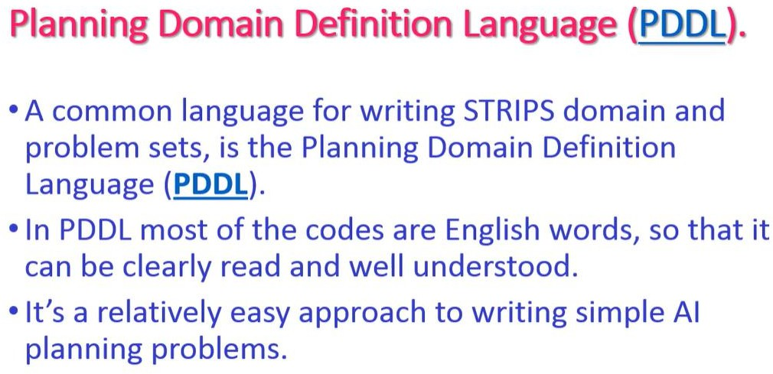

Slide 23
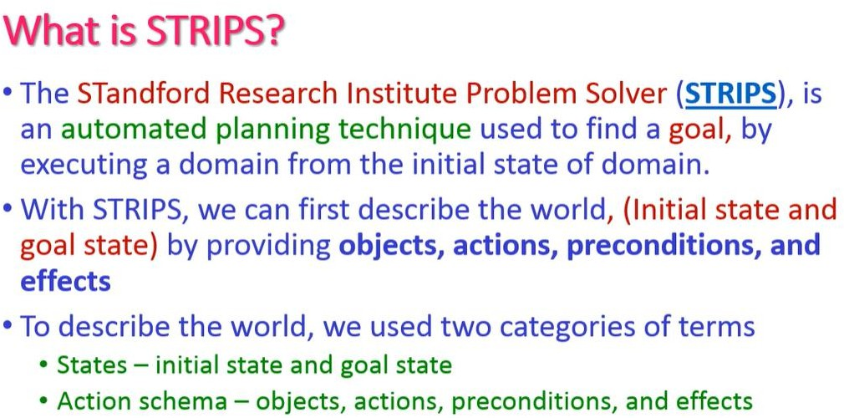

Slide 24
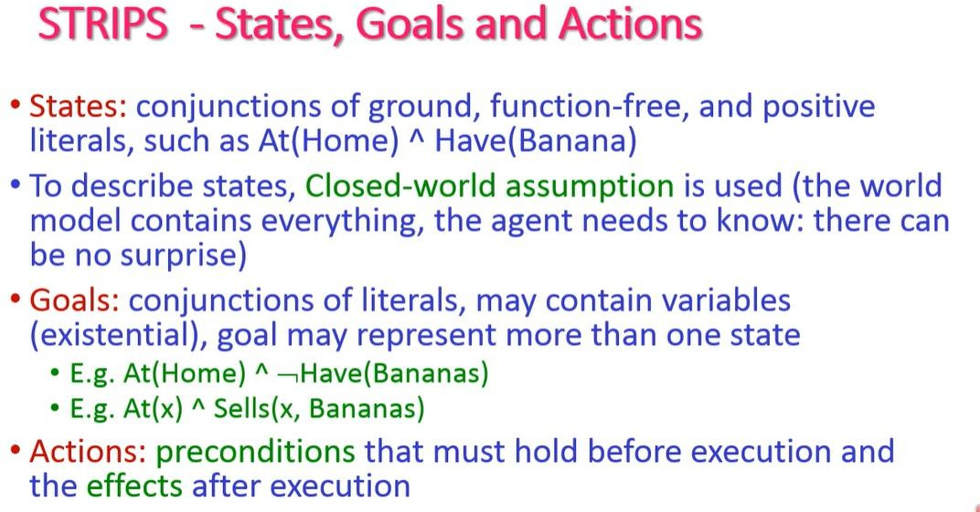

Slide 25
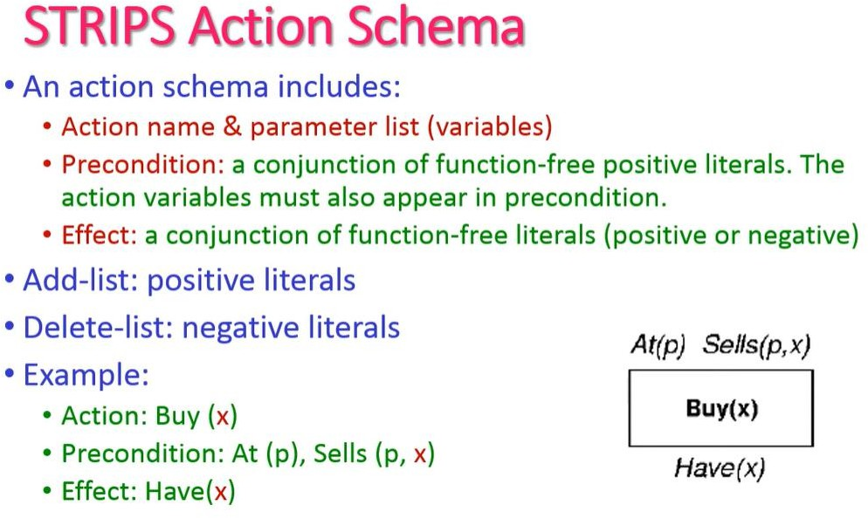

Slide 26
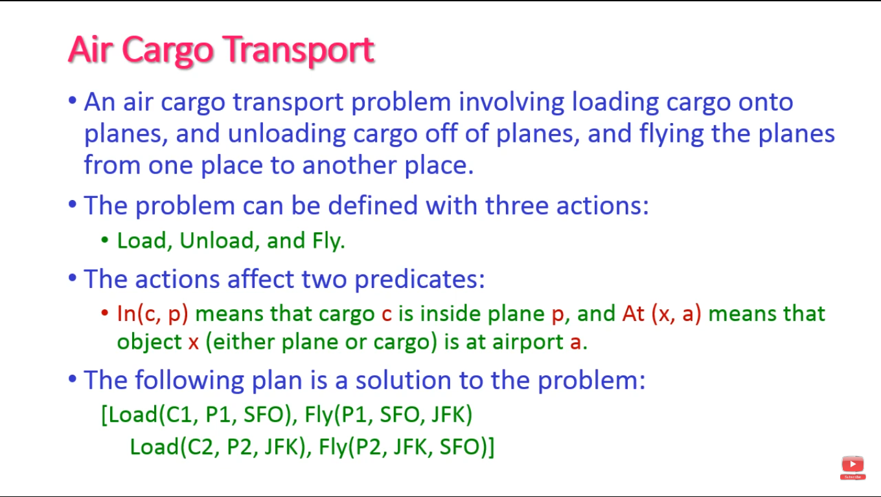

Slide 27
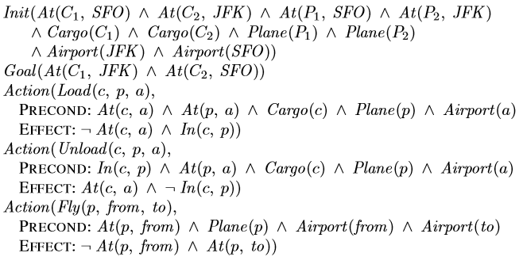
Example: Air cargo transport
Figure shows an air cargo transport problem involving loading and unloading cargo and ﬂying it from place to place.

Slide 28
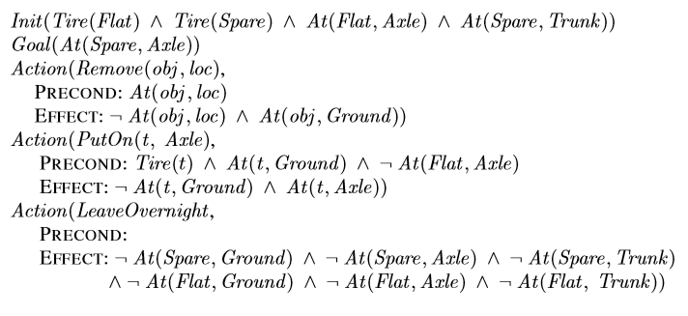
Example: The spare tire problem
Figure problem of changing a ﬂat tire

Slide 29
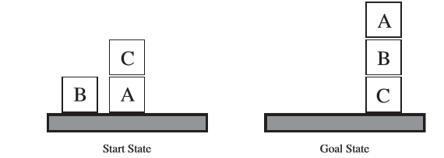
Example: The blocks world
One of the most famous planning domains is known as the blocks world.
The blocks can be stacked, but only one block can ﬁt directly on top of another.
A robot arm can pick up a block and move it to another position, either on the table or on top of another block.
The arm can pick up only one block at a time, so it cannot pick up a block that has another one on it.
The goal will always be to build one or more stacks of blocks
Figure The blocks world

Slide 30
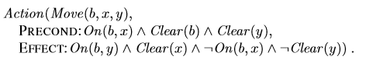
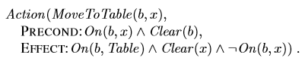
Example: The blocks world
Figure The blocks world

Slide 31
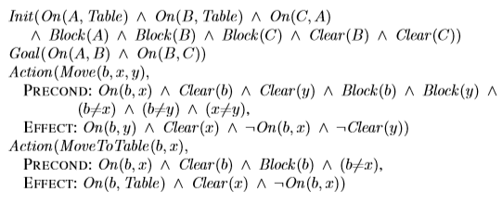
Example: The blocks world
A planning problem in the blocks world: building a three-block tower. One solution is the sequence
[MoveToTable(C,A),Move(B,Table,C),Move(A,Table,B)].
Figure The blocks world

Slide 32
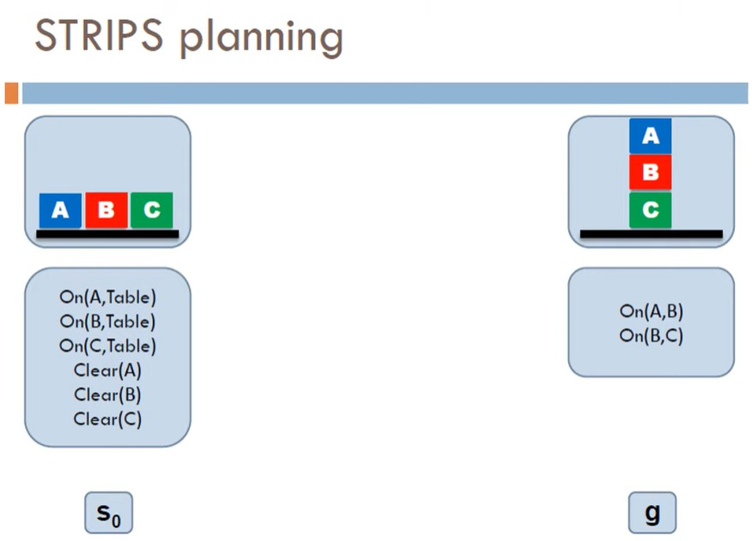

Slide 33
